Slide 1
Full Step
Membrii:
Iloaie Ionica
Tamas Bogdan
Solcan Moise
Darius Scridon

Slide 2
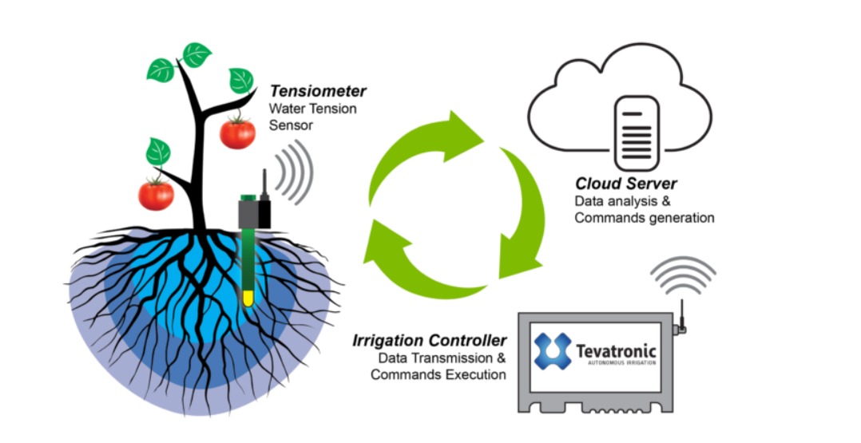
Autonomus Irrigation System

Slide 3
What is WBs?
A work-breakdown structure (WBS) in project management and systems engineering, is a deliverable-oriented breakdown of a project into smaller components. A work breakdown structure is a key project deliverable that organizes the team's work into manageable sections. The Project Management Body of Knowledge defines the work-breakdown structure "A hierarchical decomposition of the total scope of work to be carried out by the project team to accomplish the project objectives and create the required deliverables."

Slide 4
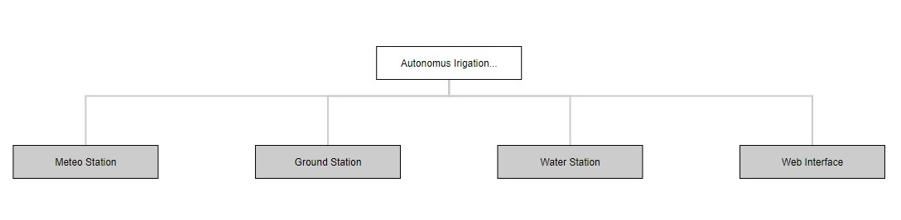
A Basic WBs

Slide 5
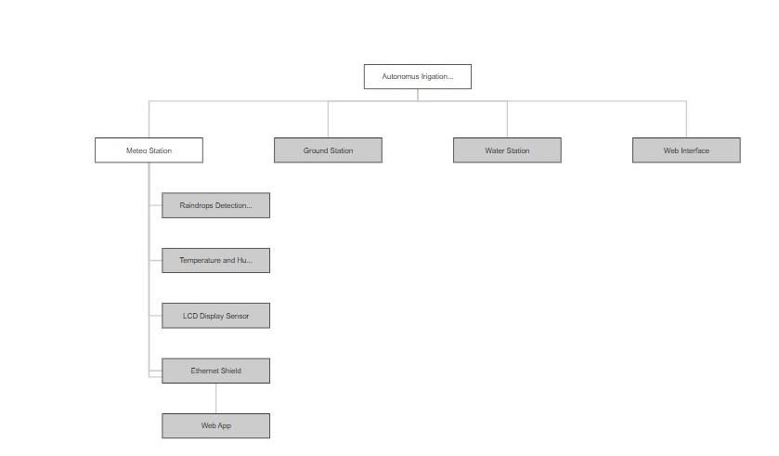
Meteo Station

Slide 6
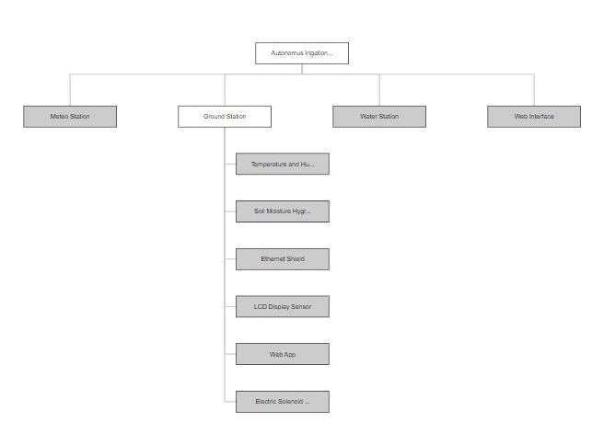
Ground station

Slide 7
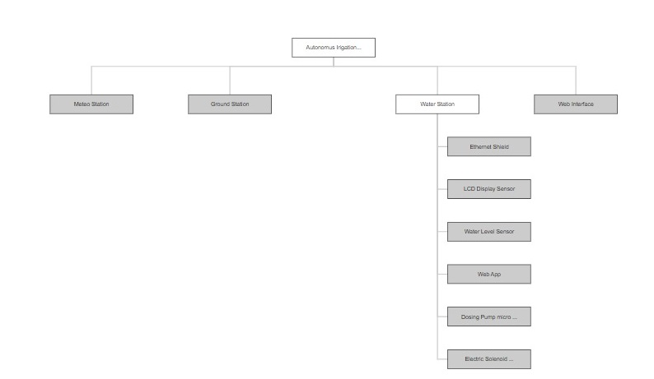
Water Station

Slide 8
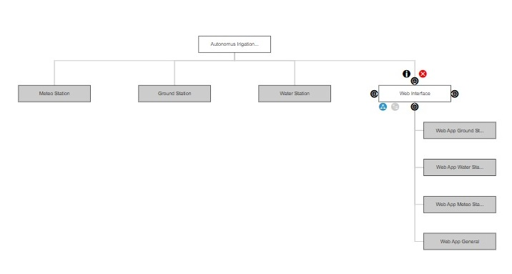
Web Interface

Slide 9
Thank you!

